Slide 1



Starve Wars
Alissa Borg and Micheal Puccini

Slide 2

Game Overview
• What is Starve Wars?
• A multiplayer survival game set in a dystopian arena where players fight to outlast each other by collecting food and avoiding hazards.
• Key mechanics: health depletion, food collection, power-ups, and environmental hazards.
• Setting: A football stadium in a vast desert, with a haunting dystopian atmosphere.

Slide 3
Our Inspiration
• Inspiration: Combining our love for retro survival games with modern multiplayer mechanics.
• Unique Selling Points:
• Fast-paced gameplay with humor and strategy.
• Focus on quick, competitive rounds that engage both casual and competitive players.
• Appealing to Our Target Audience: Designed for mobile gamers between ages 12-35 who enjoy strategy and multiplayer action.

Slide 4
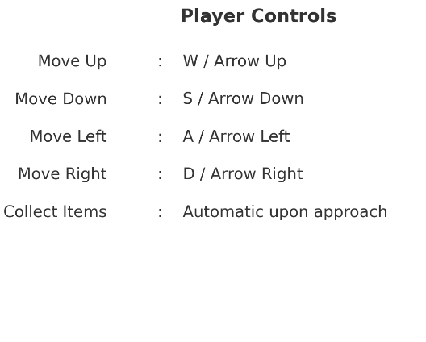
How to PLay
• Objective: Outlast opponents by collecting food and using power-ups while navigating a hazardous arena.
• Controls:
• WASD/Arrow Keys for movement.
• Collect items by moving close to them.
• Deliver collected food to the chef to gain points.
• Winning: Complete level objectives, avoid enemies, and be the last player standing.
• Losing: Health depletion, failure to meet level objectives, or running out of time.

Slide 5
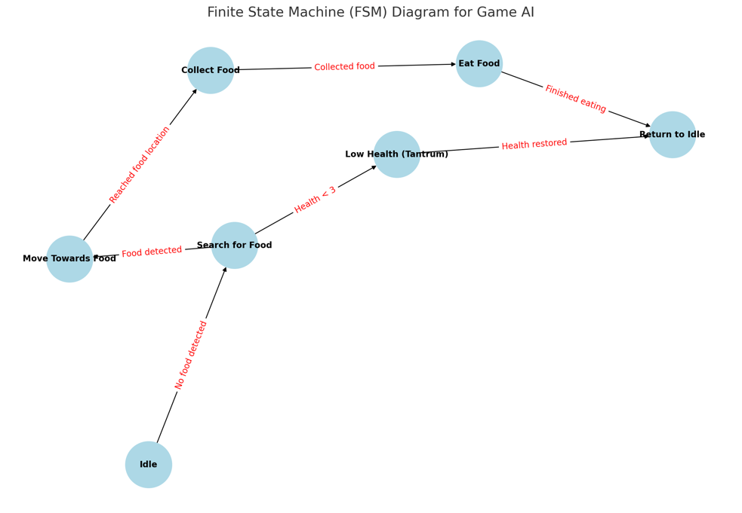
Ai Systems
• State Machines:
• AI enemies (Chef, Foodie, Minelayer etc ) operate using state machines to navigate and interact with players.
- AI adjusts based on player actions and environmental changes.

Slide 6
Teamwork and Roles
• Collaborative Effort:
• Alissa Borg and Michael Puccini worked together on design, coding, and testing.
• Alternating roles between writing, development, and testing.

Slide 7
Conclusion
Why Starve Wars?
• Unique blend of humor, strategy, and fast-paced multiplayer action.
• Key Takeaways:
• Competitive survival in a dynamic environment.
• A team effort blending creative design with technical expertise.

